Slide 1
Restricting and Sorting Data
Chapter 3

Slide 2
Syntax diagram for WHERE and ORDER BY:
SELECT [
SELECT [Distinct] {*, column [alias],…}
FROM table
[WHERE condition(s)]
[ORDER BY {col(s) | expression | position}
[ASC | DESC] [NULL FIRST | LAST]];
If present, the WHERE clause must follow the FROM clause
ORDER BY is always last

Slide 3
By the end of this class, you will understand:
SELECT first_name, job_id, commission_pct, salary, hire_date
FROM employees
WHERE UPPER(job_id) LIKE 'SA\_%' escape '\'
AND commission_pct IS NOT NULL
AND salary BETWEEN 8000 and 9500
AND hire_date < '01-MAR-00'
AND first_name LIKE '&Employee_first_initial' || '%'
ORDER BY 3 ASC;

Slide 4
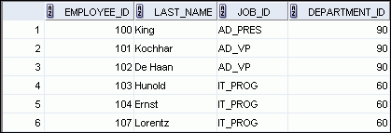

Selection Using the WHERE clause
WHERE department_id = 90
Boolean Expression
EMPLOYEES
Each candidate row is checked to see if it makes the Boolean True or False.
Rows that make the Boolean true become part of the result set.
…
result set
Notes:
Oracle Database 11g: SQL Fundamentals I 2 - <number>
Limiting Rows Using a Selection
In the example in the slide, assume that you want to display all the employees in department 90. The rows with a value of 90 in the DEPARTMENT_ID column are the only ones that are returned. This method of restriction is the basis of the WHERE clause in SQL.

Slide 5
WHERE condition will use one of the following comparison operators:
= < > <= >= <> !=
BETWEEN
  Between 2 values (inclusive)
IN (list)
  Match any one in a list of values
LIKE
  Match a character pattern
IS NULL
  Is a null value

Slide 6
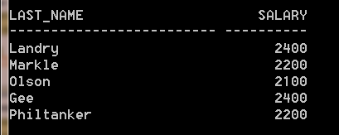
Example—comparison operator:
SELECT last_name, salary “Sal”
FROM employees
WHERE salary < 2500;
Note: you cannot use a column alias, such as “Sal” in the WHERE clause

Slide 7
Numeric data
SELECT last_name, salary
FROM employees
WHERE salary < ‘2500’;
Character data is automatically
converted to a number, but
It is not a good idea to put
Quotes around a number.

Slide 8
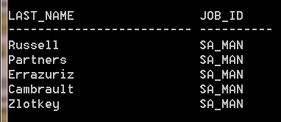
Character data
SELECT last_name, salary
FROM employees
WHERE job_id = ‘SA_MAN’;

Slide 9
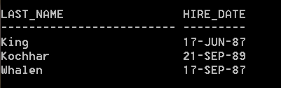
Date data
SELECT last_name, hire_date
FROM employees
WHERE hire_date < ’01-JAN-90’;
For dates,
< means “occurs earlier”
> means “occurs later”

Slide 10
Example--the BETWEEN operator
SELECT last_name, salary
FROM employees
WHERE salary BETWEEN 3000 AND 3200;
Are the endpoints
Included in the result set?
(Yes, they are)
Another example:
WHERE hire_date BETWEEN ‘01-JAN-09’ AND ’31-DEC-09’;

Slide 11
Example--the IN operator
SELECT employee_id, manager_id
FROM employees
WHERE manager_id IN (100, 120, 124);
Same as several “OR” clauses:
manager_id = 100 OR
manager_id = 120 OR
manager_id = 124

Slide 12
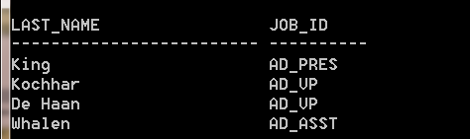
Example—the LIKE operator
(pattern matching):
SELECT last_name, job_id
FROM employees
WHERE UPPER(job_id) LIKE ‘AD%’;
WHERE job_id LIKE ‘ad%’;
No rows selected.

Slide 13
Character literals and dates
Are enclosed in single quotation marks
Character literals are case sensitive
Date values are format sensitive
Default date value is DD-MON-RR
To perform wildcard searches:
% denotes zero or many characters
_ denotes a single character

Slide 14
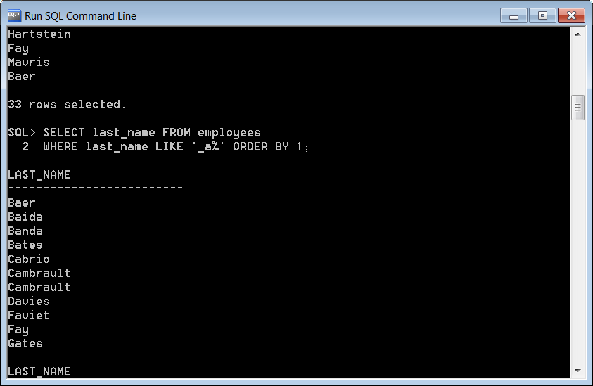
What does this query select?
SELECT last_name
FROM employees
WHERE last_name LIKE ‘_a%’;
Pattern must be on
the righthand side of
the word LIKE, else
The query will run but
No rows will be returned.

Slide 15
Escape – used if you need to search for literal that contains a ‘%’ or ‘_’
Temporarily disables the special meaning of ‘%’ or ‘_’
Example:
Retrieve the last name and job_id of all employees whose job begins with ‘SA_’ (where ‘_’ has its traditional meaning of underscore)

Slide 16
WHERE job_id LIKE ‘SA_%’;
WHERE
job_id LIKE ‘SA\_%’ ESCAPE ‘\’;
Denotes any single character
Denotes the ESCAPE
character
Denotes the
Underscore character;
Usual meaning
Denotes the
Wild card character

Slide 17
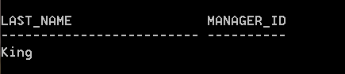
Using the IS NULL operator
SELECT last_name, manager_id
FROM employees
WHERE manager_id IS NULL;
Do NOT use “= NULL”.
Must use “IS NULL”.

Slide 18
LOGICAL operators
AND – returns true if both component conditions are true
OR – returns true if either component conditions are true
NOT – returns true if the condition is false

Slide 19
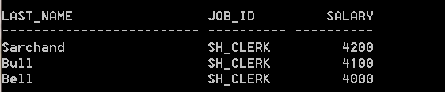
Using the AND operator
SELECT last_name, job_id, salary
FROM employees
WHERE salary >= 4000
AND job_id LIKE ‘%CLERK%’;

Slide 20
AND Truth table
AND
T
F
null
T
T
F
null
F
F
F
F
null
null
F
null
Notes:
*
07/16/96
*
##

Slide 21
Using the OR operator
SELECT last_name, job_id, salary
FROM employees
WHERE salary >= 4000
OR job_id LIKE ‘%CLERK%’;
Notes:
*
07/16/96
*
##

Slide 22
OR Truth table
OR
T
F
null
T
T
T
T
F
T
F
null
null
T
null
null

Slide 23
Using the NOT operator
SELECT last_name, job_id
FROM employees
WHERE job_id NOT IN (‘SA_REP’,‘SA_MAN’);

Slide 24
NOT Truth Table
NOT
T
F
null
F
T
null

Slide 25
NOT can be used with other SQL operators.
…WHERE salary NOT BETWEEN 1000 AND 2000;
…WHERE last_name NOT LIKE ‘%A%’;
…WHERE commission_pct IS NOT NULL;

Slide 26
Rules of precedence
1. All comparison operators (=, <, …)
2. NOT
3. AND
4. OR
NOTE: you can override precedence by using parenthesis

Slide 27
Example:
SELECT last_name, job_id, salary
FROM employees
WHERE job_id LIKE ‘SALESMAN’
OR job_id LIKE ‘ANALYST’
AND salary > 1500;
Does this query return the Salesmen and analysts who earn more than 1500?

Slide 28
SELECT last_name, job_id, salary
FROM employees
WHERE job_id LIKE ‘SALESMAN’
OR job_id LIKE ‘ANALYST’
AND salary > 1500;
No– it returns the analysts who earn more than 1500, PLUS ALL of the salesmen, regardless of what they earn
Evaluated first

Slide 29
Using parenthesis to force priority:
SELECT last_name, job_id, salary
FROM employees
WHERE (job_id LIKE ‘SALESMAN’
OR job_id LIKE ‘ANALYST’) AND salary > 1500;
Now it returns all salesmen and analysts who earn more than 1500.

Slide 30
ORDER BY clause
Use to sort rows
If no ORDER BY clause is used, the sort order is not defined, and the Oracle Server may not fetch rows in the same order for the same query twice.

Slide 31
Sorting by a column:
SELECT last_name, job_id, hire_date
FROM employees
ORDER BY hire_date;

Slide 32
ASC (ascending) is the default
Numeric values displayed in increasing values, for example 1 – 99
Date values are displayed with the earliest first, for example 01-01-92 before 02-02-05
Character values are displayed in alphabetical order
Null values are displayed last

Slide 33
Sorting by a column alias
SELECT last_name, salary * 12 AS “annsal”
FROM employees
ORDER BY “annsal”;

Slide 34
Sorting by column number in the select list
(Col 1)
(Col 2)
SELECT employee_id, last_name
FROM employees
ORDER BY 1;

Slide 35
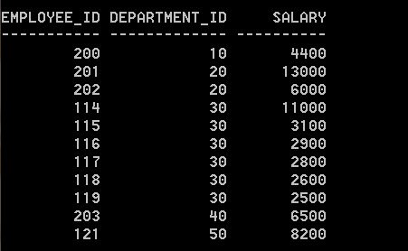
Sorting by multiple columns
SELECT employee_id, department_id, salary
FROM employees
ORDER BY 2, salary DESC;
Department_id sorted
Ascending, within the
same department, sorted
by Salary, Descending
Notes:
*
07/16/96
*
##

Slide 36
You can also sort by a column that is not in the select list
SELECT last_name, salary
FROM employees
ORDER by department_id;
Notes:
*
07/16/96
*
##

